Slide 1

VRP- Vehicle Routing Problem
Analytics COC
1

Slide 2
Practice Problem : Loan Prediction
Description: To Find the defaulter by learning algorithms from previous data

Slide 3
Loan Prediction – Solved By Methods
Supervised learning:
Linear regression
Logistics regression
Random Forest Classifier
Oversampling:
Random Oversampling
SMOTE: Synthetic Minority Over-sampling Technique
ADASYN
One Hot Encoding

Slide 4
Loan Prediction – Library Used
Pandas
Numpy
Scikit learn
Seaborn
Matplot
imblearn

Slide 5
Loan Prediction – Results
0.6975165310042764
benchmark Score (The Person who had solved with this database): 0.6975165310042764
My Cross Val Score : 0.7961374
Confusion Matrix

Slide 6
Problem :VRP- Vehicle Routing Problem
Description:
To Find the optimal route for given list of addresses

Slide 7
Problem :VRP- Vehicle Routing Problem
Features :
It is modular (Work in Progress)
Barcode generator for address
One Depot & One vehicle
One Depot & ‘N’ no of vehicles
‘M’ no of Depots & ‘N’ no of vehicles
Sending a particular vehicle to a particular address
Real time Package Addition (Capacity Constrained is remaining)
Capacity Constrained
Assigning Vehicle to Depot as pre requirement ( Work in Progress )

Slide 8
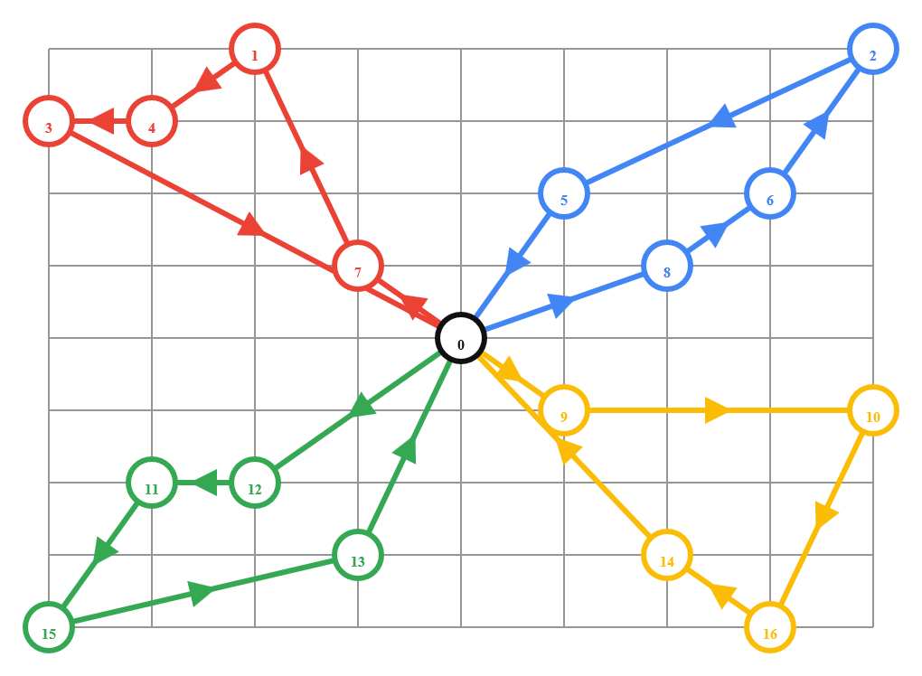

Slide 9
VRP- Vehicle Routing Problem – Library Used
Pandas
Numpy
ORtools
Python-barcode
Random
Harvsine
Unit
Flask
Janja2

Slide 10
Problem :VRP- Vehicle Routing Problem
Web Application For User Input & Address/Barcode Display using HTML, CSS , Bootstrap4

Slide 11
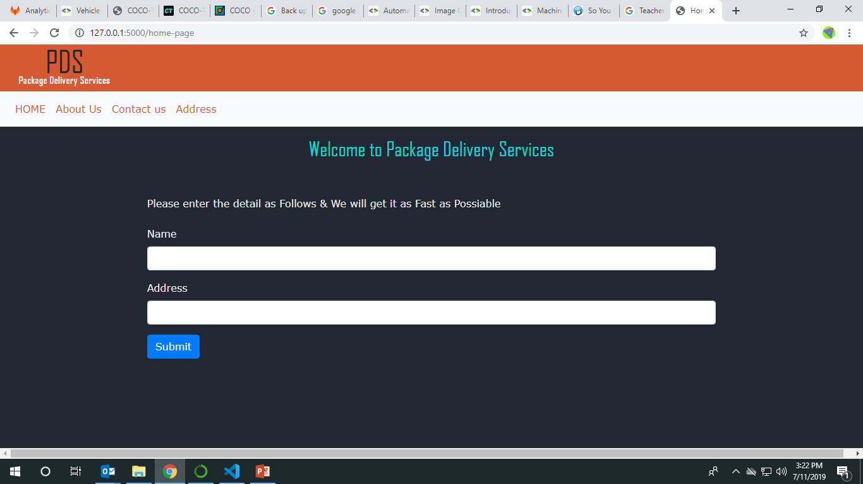

Slide 12
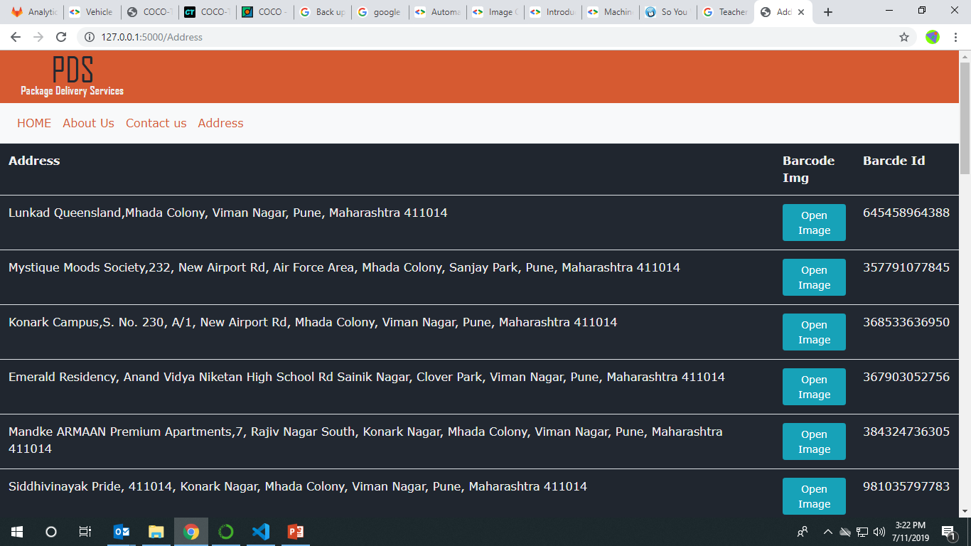

Slide 13
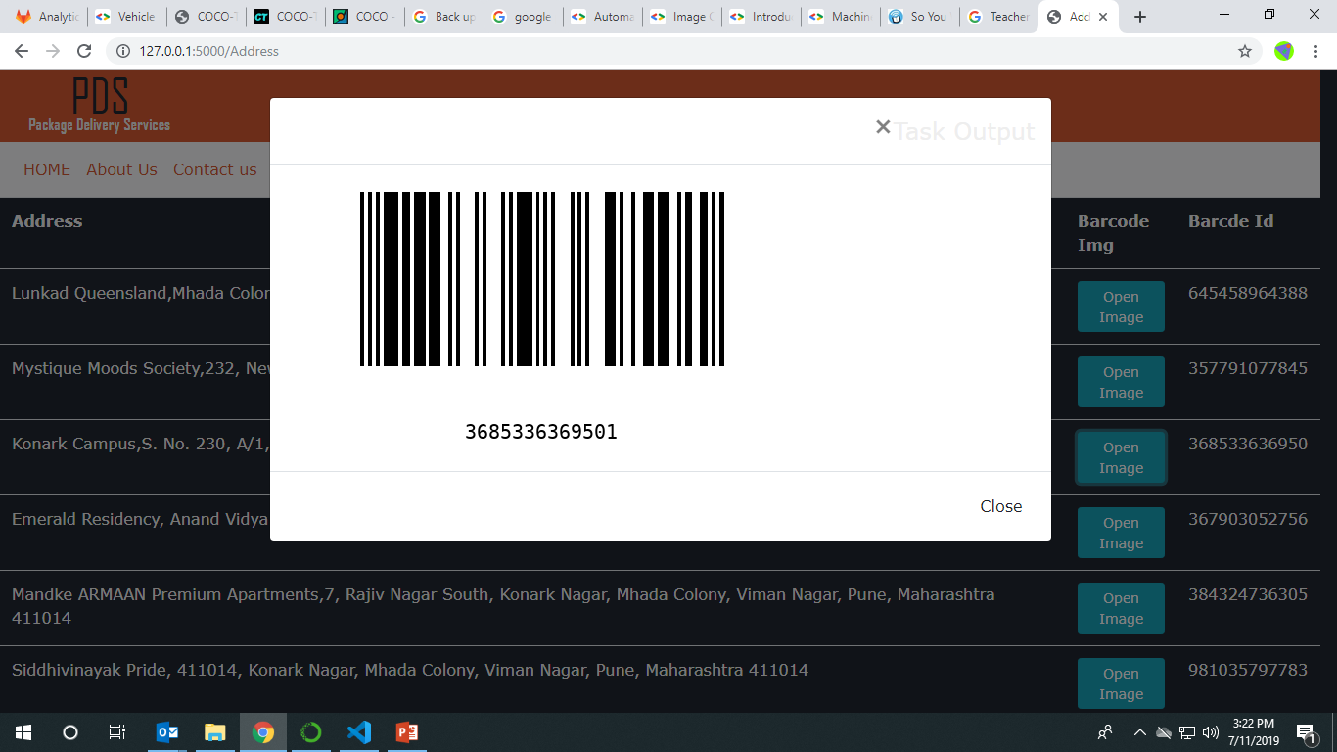

Slide 14
Problem :VRP- Vehicle Routing Problem
OUTPUT FOR NOW

Slide 15
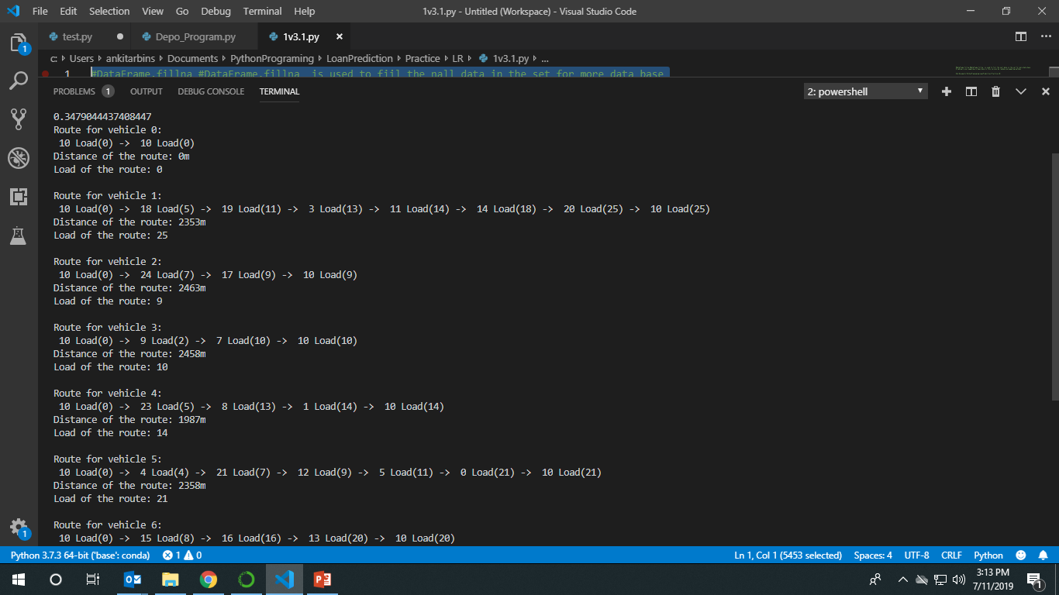

Slide 16
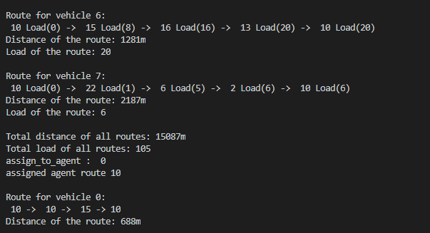

Slide 17

Thank You
11-07-2019
17
Notes:
17

